Slide 1
IE+ AT THE CABINET LEVEL:
AN ORGANIZATIONAL CASE STUDY
Braden Hosch, Vice President for Educational & Institutional Effectiveness
Catherine Scott, Director of Educational Effectiveness
May 30, 2024 | AIR Annual Forum (Denver, CO)

Slide 2
“Never let a serious crisis go to waste.”
Rahm Emmanuel White House Chief of Staff (2009-10) Mayor of Chicago (2011-19)

Slide 3
Overview
Current state
How we got here
Structural & cultural differences
Takeaways

Slide 4
Current State

Slide 5
Stony Brook University
25,865 Fall 2023 headcount enrollment | 1400 Median SAT 2023 (test optional) | 93.5 Avg. high school GPA
68% 32% Undergrad Graduate | 38% Receive Pell grants | 30% 28% 19% White Asian URM
16,309 Fall 2023 employees incl. health system | 3,028 Fall 2023 faculty full-time & part-time | #58 U.S. News & World Report Rank 2024
4.5 Billion USD annual budget 2024 | 1957 Founded | 2001 Joined AAU

Slide 6
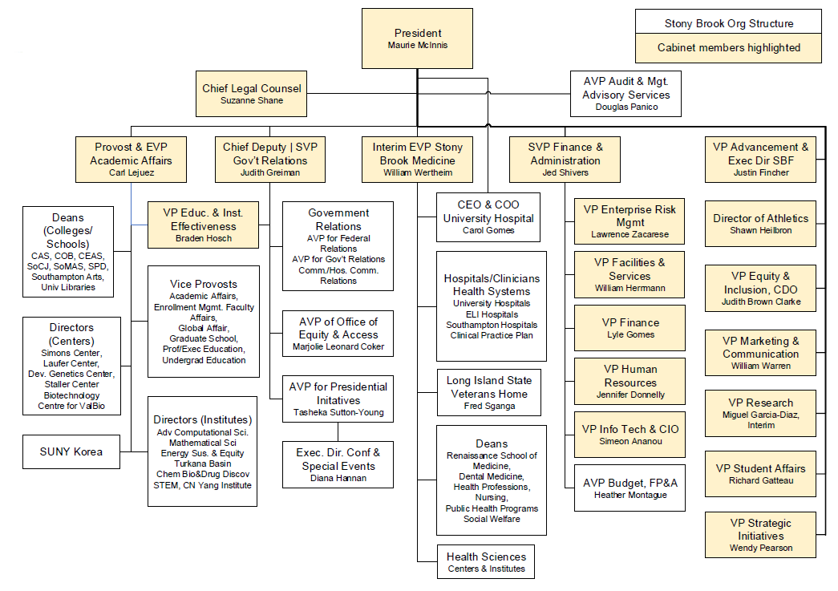
Cabinet Org Chart
May 2024

Slide 7
https://www.stonybrook.edu/effectiveness/

Slide 8
Mission and Strategic Goals
We enable Stony Brook University to improve through the collection, analysis, and use of data.
Collect administrative and contextual data using high-quality processes for extraction, storage, curation, indexing, and disposition.
Understand the data collected by us and by others to know its meaning, context, limitations, and implications for action.
Communicate data and analyses clearly and effectively to internal and external audiences.
Improve how the university and all members of its community achieve their goals.

Slide 9
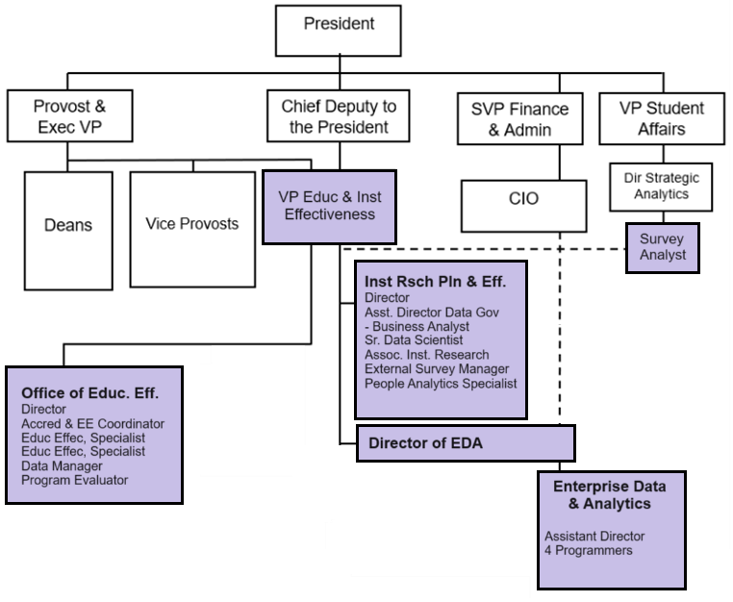
Org chart Sept 2022 and later
Cross-functional responsibilities
Accreditation
Strategic Plan Monitoring
Data Governance

Slide 10
Collaborations Made Easier By Cabinet-Level Position

Slide 11
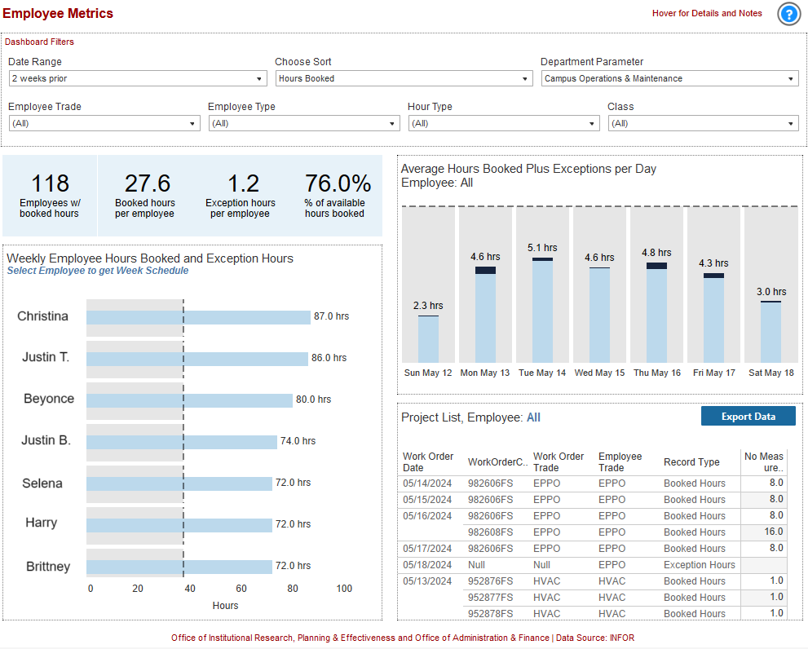
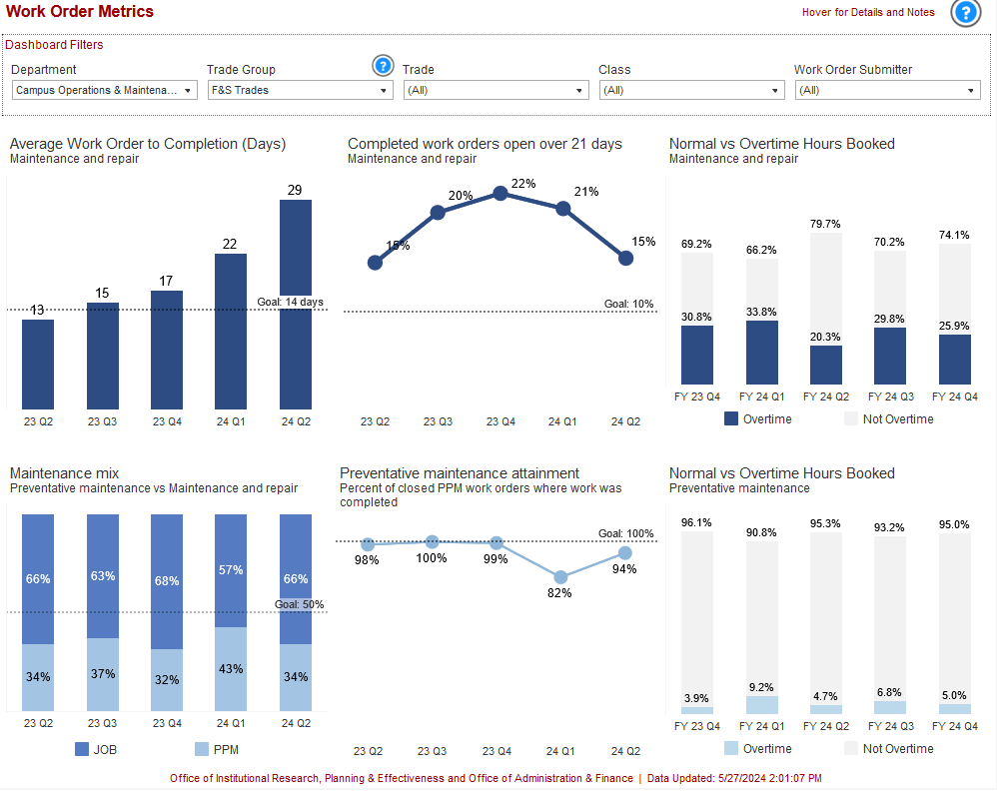
Work Orders Dashboards Partners: Institutional Research, Analytics, Facilities & Services

Slide 12
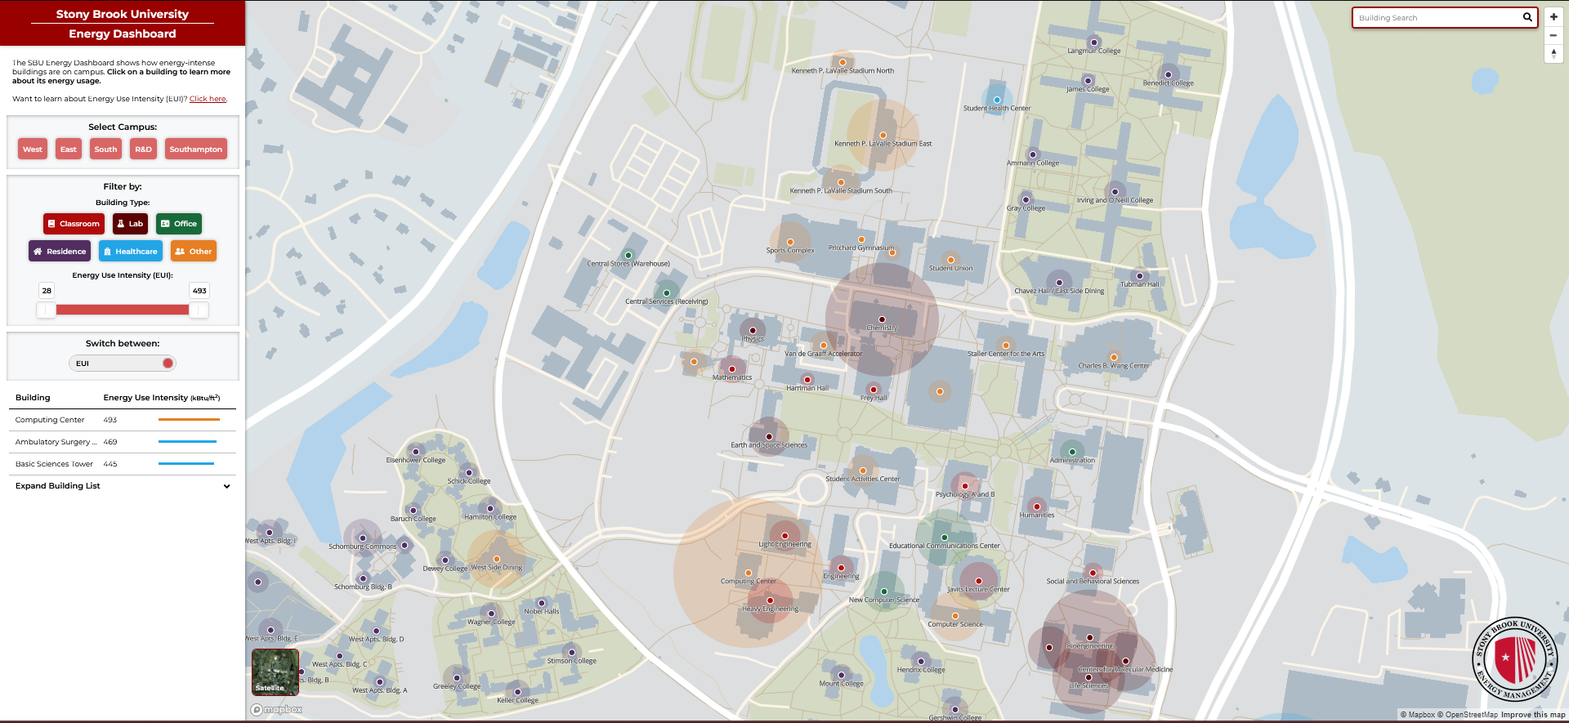
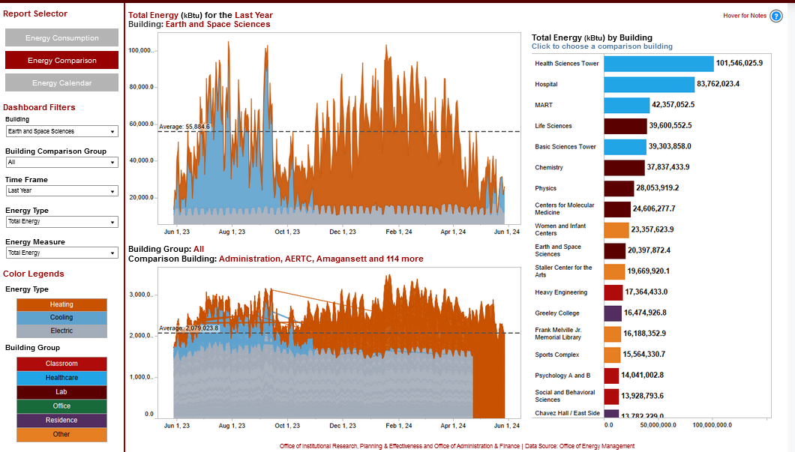
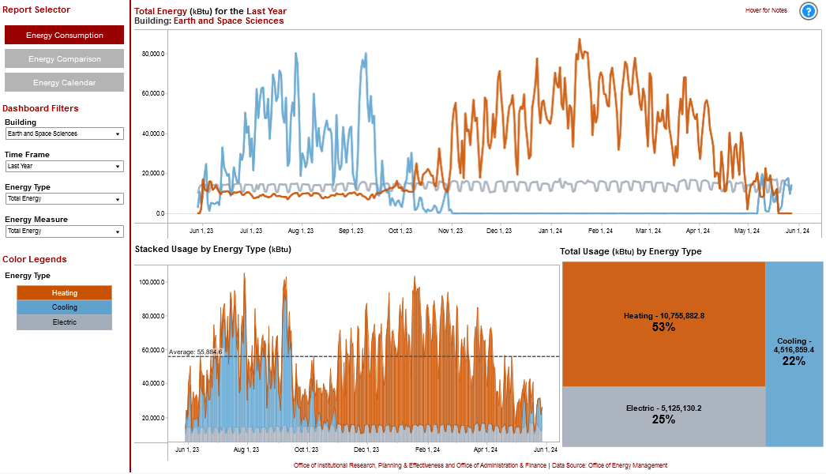
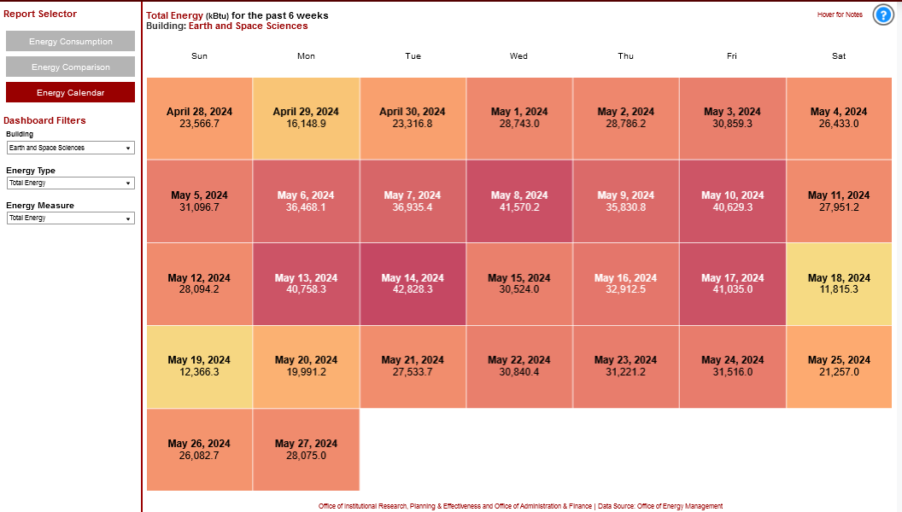
Energy Dashboards Partners: Analytics, Data Warehousing, Sustainability

Slide 13
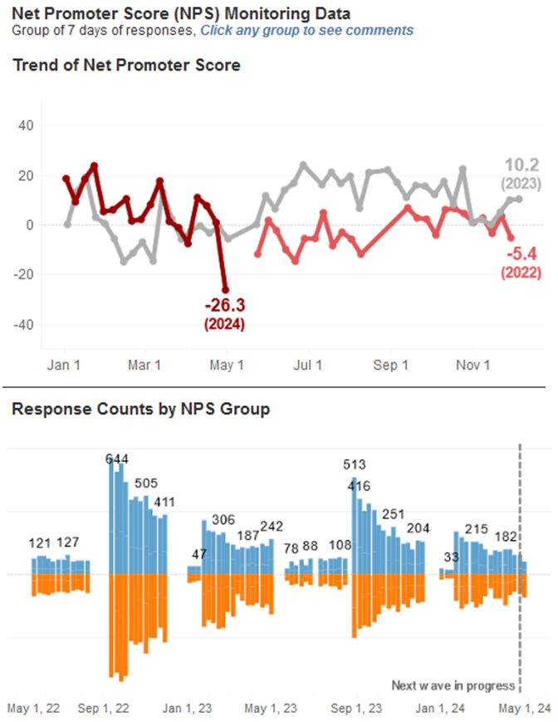
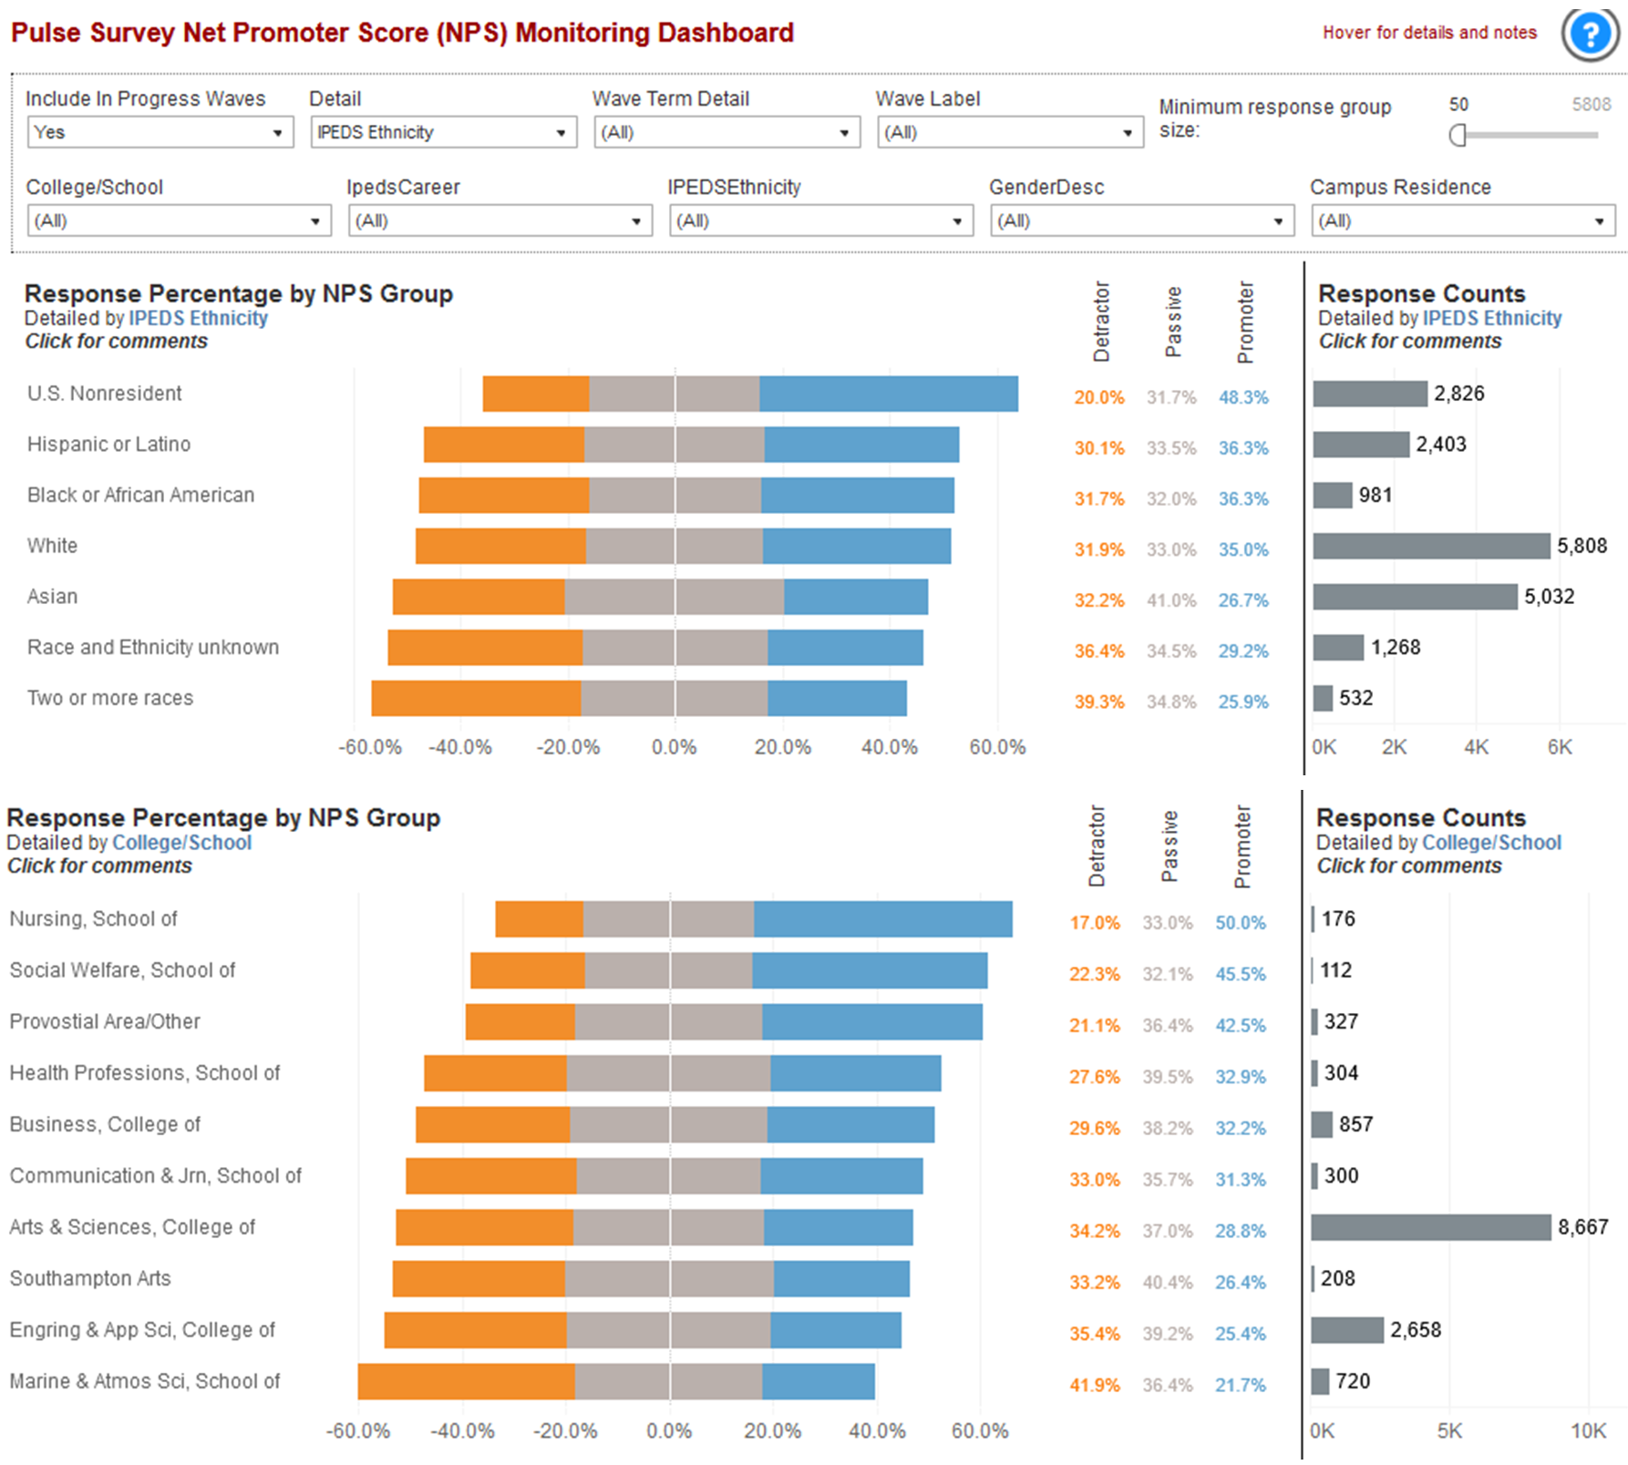
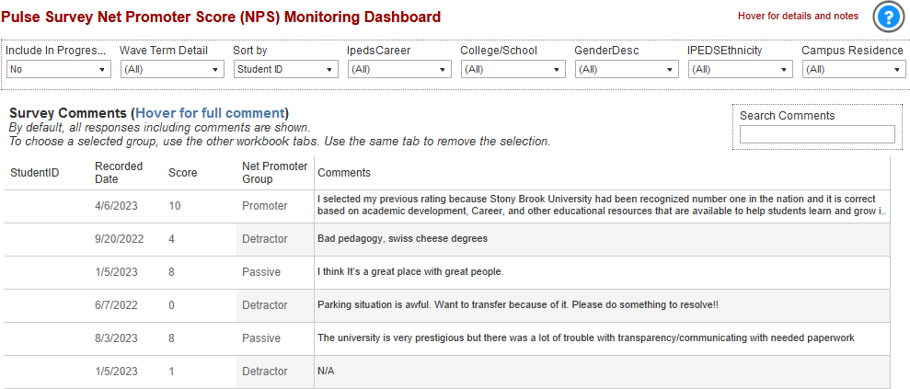
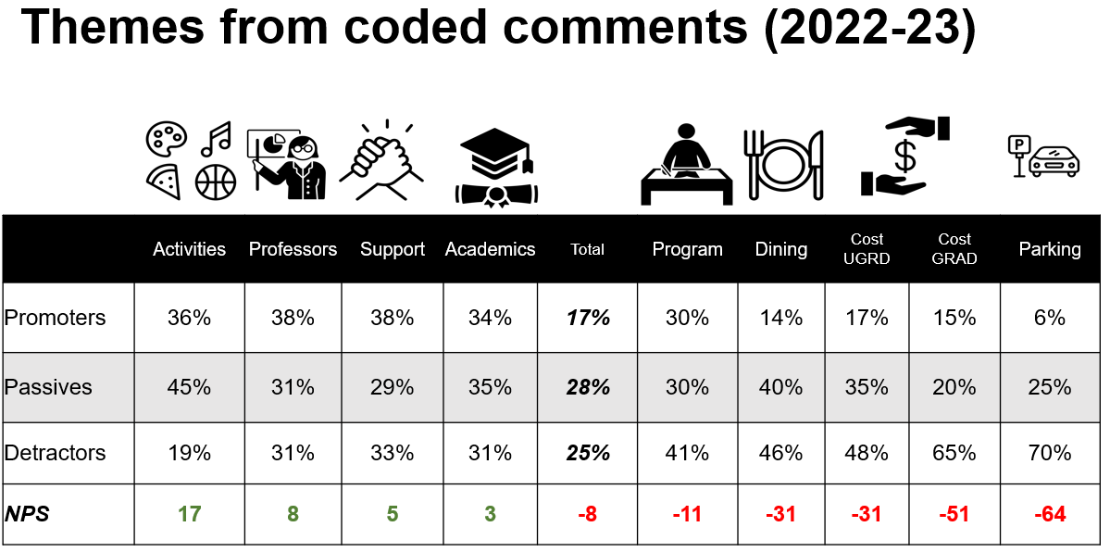
Weekly Pulse Survey Partners: Institutional Research, Analytics, Student Affairs

Slide 14
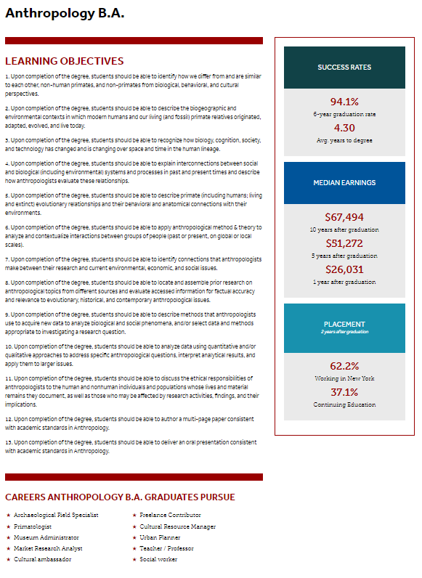
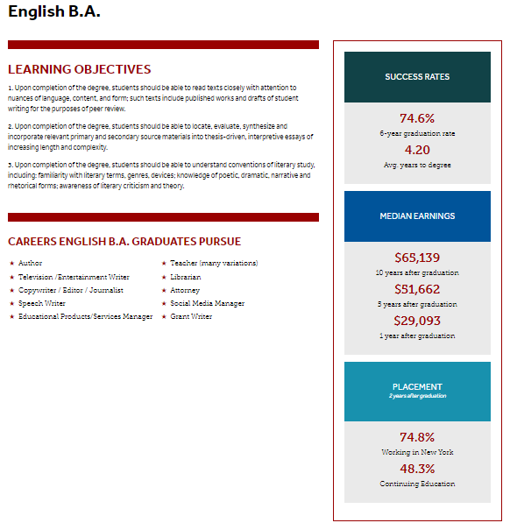
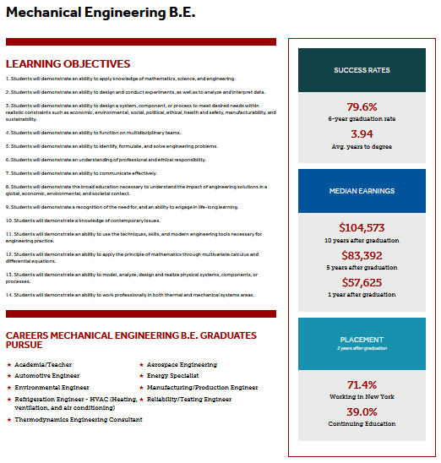
Program Outcomes Partners: Educational Effectiveness, Institutional Research

Slide 15
Transformation

Slide 16
Prior State Org Charts
President
Provost
VP Strategic Initiatives
CIO
Office of Academic Assessment
Institutional Research
Data Warehouse

Slide 17
Transformation of Assessment Function

Slide 18
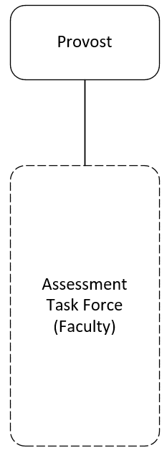
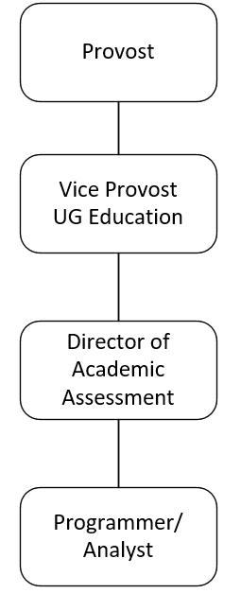
Assessment Structures Prior to 2022
Assessment Task Force
2011-2014
Office of Academic Assessment
2017-2021
Numerous accreditation
recommendations about
assessment (2014)
SLOW
Progress.
Disbanded
2021

Slide 19
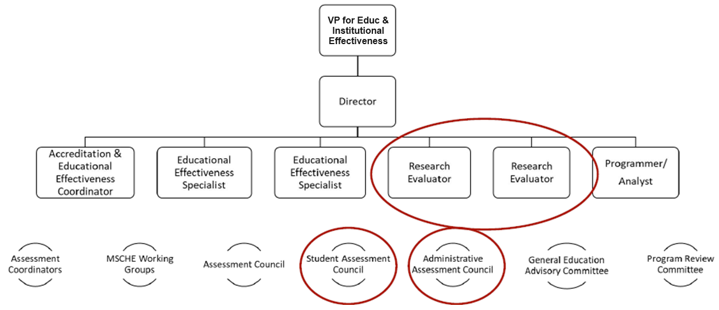
Office of Educational Effectiveness (2022 - )

Slide 20
Accomplishments - Assessment
Academic Programmatic Assessment
Every academic program has an identified assessment coordinator.
Achieved a 95% collection rate of academic assessment reports in both 2022 and 2023.
Collected a total of 350 assessment reports across two years.
General Education Assessment
Evaluated 39,612 duplicated students.
Assessed performance across all 69 learning outcomes.
Conducted assessments in 210 course sections involving 107 faculty members.

Slide 21
Accomplishments – Groups, Policies & Procedures
Assessment Council
Assessment policy
Feedback mechanism
General Education Advisory Committee (GEAC)
Student learning outcome alignment and modification
Re-Booted Program Review
Staffed ad hoc committee to develop program review policy & procedures
Facilitation of 8 programs through new process in 2023-24
Accreditation Advisory Group
Liaisons from programs with specialized accreditation

Slide 22
Accomplishments - Events
Annual Assessment Symposium
22: Over 80 attendees
23: Over 100 attendees
Assessment Recognition
23: Assessment champions
24: Excellence in Educational Effectiveness recipients
Accreditation Advisory Committee Retreat
23: Support needs discussion
24: Retreat - shared resources, EIE needs, & best practices

Slide 23
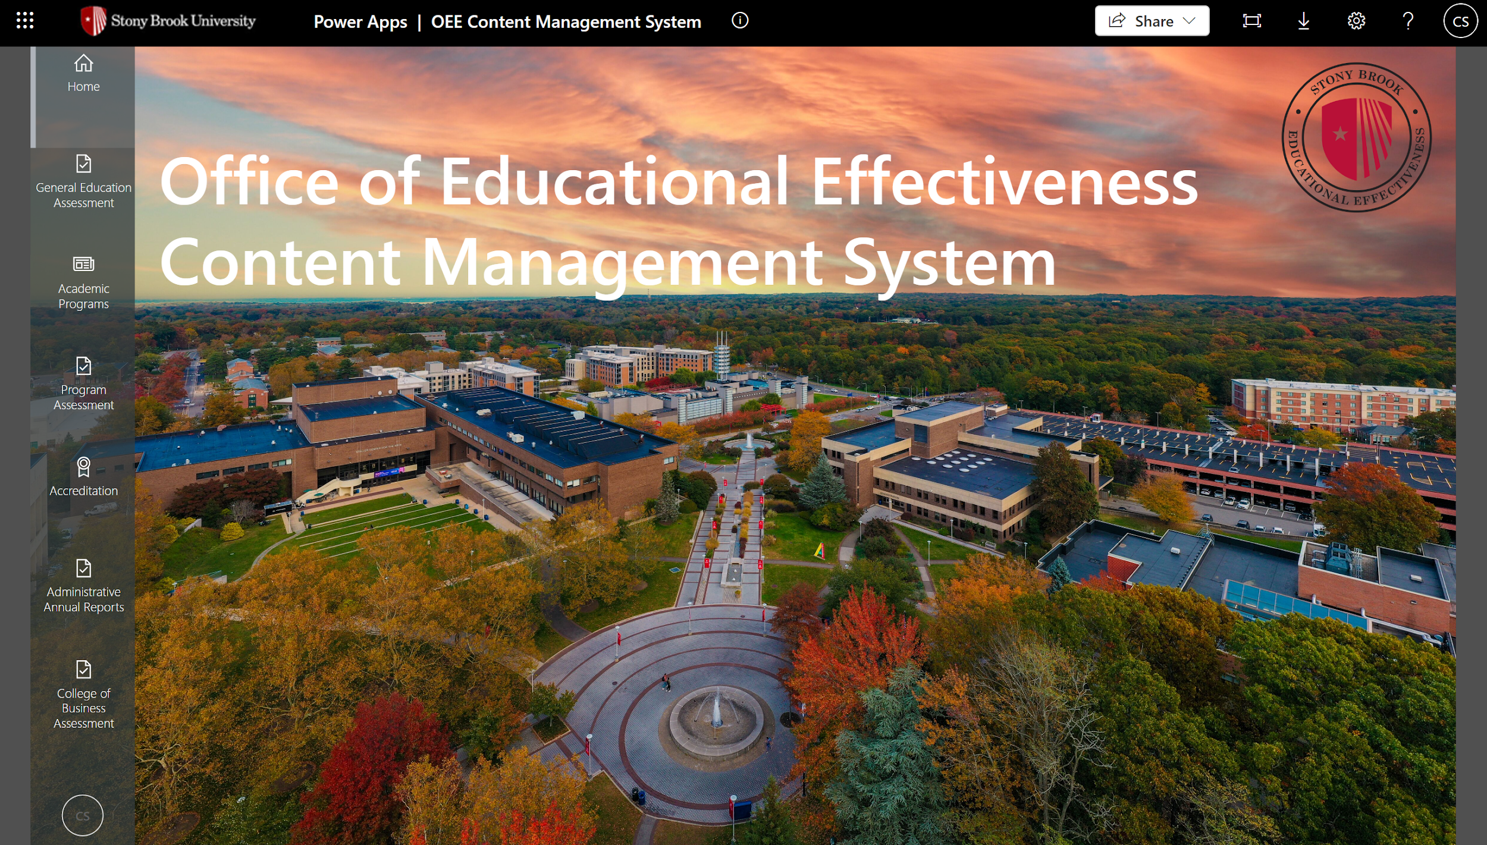
Accomplishments – Homegrown Content Management System

Slide 24
Challenges
Clarifying distinctions to external stakeholders
Clarifying internal distinctions
Time constraints for collaboration & innovation

Slide 25
Transformation of IR/IE Function

Slide 26
Evolution from Institutional Research to IE+
Prior State (until 2010)
Transformation (2013-2018)
Advanced Analytics (2019 - 2022)
Expanded Scope (2022 -
Traditional IR
Students
Courses
Faculty
“We deal with numbers without the dollar sign”
Leader: Director
New leadership
New mission/scope
Restructuring
New technology
Embedded EDA Director
Data governance
Leader: Asst. VP
Data strategy
Visualization
Modeling
Policy analysis
Leader: Assoc. VP
Accreditation
Assessment
Strategic plan monitoring
Analyst consolidation
Leader: VP
To what extent are we accomplishing our mission? How do we know? How do we improve?
Notes:
Prior state
Describe the past
Clean data, prepare error reports
Compliance reporting
Primary Audiences: ?
Current / Future state
Predict the future
Govern data, build architecture
Support university strategy (legislative advocacy
Primary audiences: VPs, AVPs, Deans
[Absent] program review support, assessment, surveys

Slide 27
Structural and Cultural Differences

Slide 28
Institutional Research, Business Intelligence, & Assessment Structural Differences
 | Business Intelligence | Institutional Research | Assessment
Organizational Reporting | IT | Provost (sometimes Planning) | Provost
Data Realms | ERP | Student & Faculty | Programmatic
Responsibilities | Data Warehouse Reporting Environment [Data Distribution] | Official Reporting Ad Hoc Requests [Data Analysis] | Process Management [Motivate others to prepare reports]
Constituencies | Internal Admin. Functions Deans | Internal & External Academic Functions Deans & Central Admin | Internal Academic External Accreditors
Data Usage | Operational Decision Support | Official Reporting Decision Support | Internal decision support External accountability
Age of Organization | Newer | Well Established (Predates BI) | Since late 1990s early 2000s
BI & IR from Childers, H. (2016). “Can business intelligence and IR teams be combined?”
Annual Forum of the Association of Institutional Research, New Orleans. Assessment features added by Hosch & Scott.

Slide 29
Institutional Research, Business Intelligence, & Assessment Cultural Differences
 | Business Intelligence | Institutional Research | Assessment
Educational Background | BA/BS, MS, IT-related | PhD common, Social Sci or Stats | MA/MS or PhD Education / Soc Sci.
Career Background | Not Academic Sometimes Not Higher Ed | Higher Ed | Higher Ed
Career Opportunities | Outside Higher Ed | Higher Ed | Higher Ed
Data Manipulation | A Crime | A Requirement | Another unit’s responsibility
Data Openness | "Democratization of Data" | Manage Carefully | Manage Very Carefully
Data Quality | Provenance Fidelity to Source | Conform to Definition; Fitness for Use; Consistency | Accepted as Imperfect
Data Understanding | Operational & Managerial Context | Institutional & Strategic Context | Programmatic Context
Agility | Generally Slow & Deliberate Enterprise Perspective | Responsive to Ad Hoc Requests | Iterative; limited by partner and institutional capacities
Attitude | Optimistic | Skeptical | Collegial
Organizational IQ | Can be Strong in ERP- Related Areas | Strong in Academic-Related Functions | Strong Interpersonal Skills, Esp. w Faculty
From Childers, H. (2016). “Can business intelligence and IR teams be combined?”
Annual Forum of the Association of Institutional Research, New Orleans.

Slide 30
Final Thoughts

Slide 31
Takeaways-How we got here
Organizational difficulties drove many of the developments
Pre-existing relationships among leaders (standing meetings, committees, etc.); evolved into structure based strengths
Leaders had multiple organizational plans prepared for when opportunities arose

Slide 32
Takeaways-Why it works
More than IR is required in the portfolio of a cabinet member
Resources are required (and were provided) to operate at a high level
The right (talented) people into the right roles
Transparency/ communication is a new value; the matrixed structure enables this and requires it.

