Slide 1
DARE TO BE
Survey Matchmaking: Choosing the Right Tool For You
Simran Kaur
Ahmed Belazi
CRAFT Team | Division of Student Affairs

Slide 2
Survey Process
Target
Who is your target population and how could this help us understand them?
How will it contribute to our current understanding?
What will you do with your data?
Goals
What actionable steps can be taken with the data collected?

Slide 3
What are (some) things that make a good question?
Make it count
One thing at a time
Don’t lead
Avoid jargon
Avoid fatigue
Test it out!

Slide 4
Process
Establish the goals of the project
What you want to learn
How you want to report
Determine your sample
Whom you will include in the process
Choose your data collection methodology
How you will learn
Pre-test (if practical)
Create your questionnaire

Slide 5
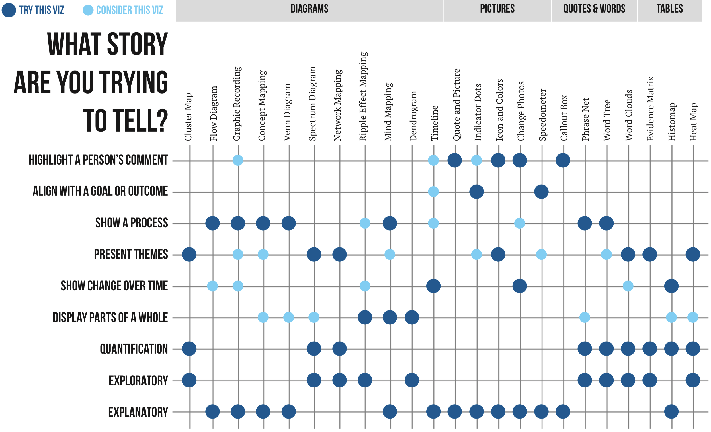

Slide 6
Process
Establish the goals of the project
What you want to learn
How you want to report
Determine your sample
Whom you will include in the process
Choose your data collection methodology
How you will learn
Pre-test (if practical)
Create your questionnaire

Slide 7
Which platform is right for me?
Create and customize a list of items
Choose items from a list of templates
Distribute the survey
Target and segment audiences
Collect responses accurately and securely
Organize data and ensure exportability
Report summary results
Conduct analysis

Slide 8
Which features are right for me?
Survey Design: Question Types (File uploading, Signature Collection), Custom elements (images/videos), Piped text, Embedded data, Question Logic, Skip logic, branching, and conditional questions, Templates & Themes.
User Experience & Accessibility: Mobile Responsiveness, Multilingual Support, ADA/WCAG compliance.
Survey Distribution: Multiple Channels (Email, SMS, social, embedded), Anonymous and Complex Tracking).
Response Management: Response Rate Tracking, Expiration, Quota Management.
Data Analysis & Reporting: Real-Time Analytics, Export Flexibility (CSV, SPSS, SFTP), Visualization Tools (Charts, graphs, heatmaps), Sentiment Analysis (text analysis).
Integration & Automation: Third-Party Integrations (CRM, Google Sheets, Tableau), Workflows and dataflows (Webhooks, Triggers, API).
Security & Compliance: Data Encryption (Storage and transmission), GDPR & HIPAA, User Access (Role-based permissions).
Collaboration & Team Management: Multi-User Access (Design Commenting & Review, Analysis, Data Export), Survey Testing.
Survey Interaction: Save & Resume, Progress Bar, Incentives, Referrals.
Cost & Scalability: $$$, Service & Support Quality, Mass Distribution.

Slide 9
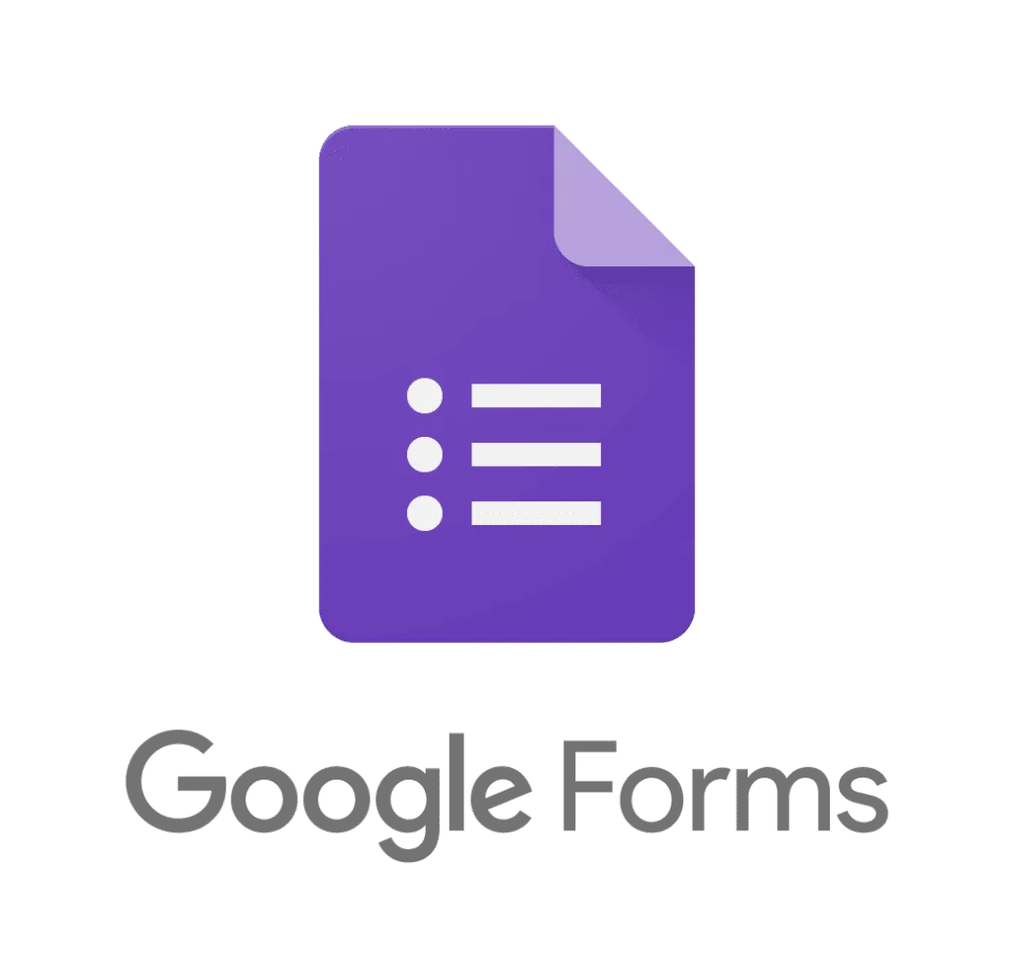
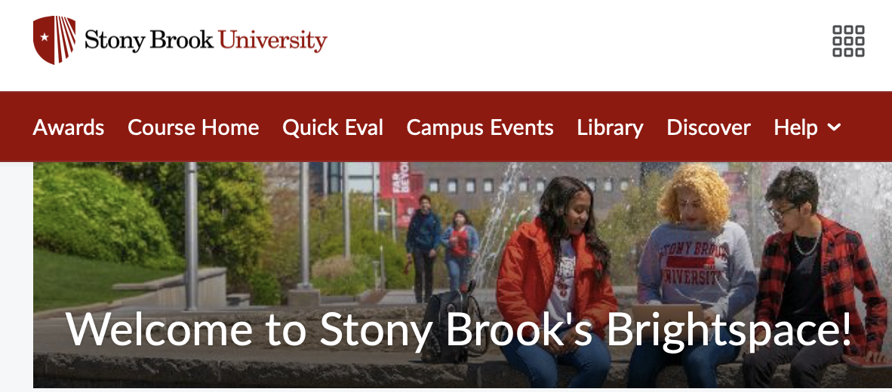
Survey Platforms
Microsoft Forms

Slide 10
Notes:
https://stonybrookuniversity.co1.qualtrics.com/survey-builder/SV_b11u3dIKESo1SMC/edit

Slide 11
Other Resources
Love Data Week Presentation - Swipe Right on Surveys: Designing Questions Everyone Will Love
Survey Management Guide
Question Type Flow Chart
Qualtrics: Writing Good Questions
Stephanie Evergreen: Data Visualization Checklist

Slide 12
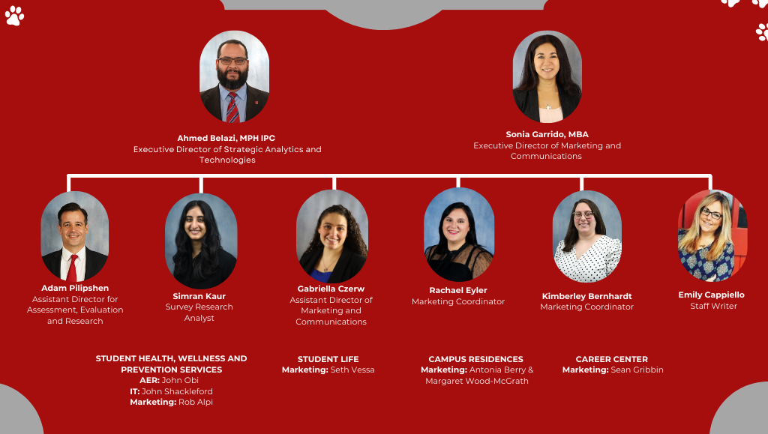
Email us!
Ahmed: ahmed.w.belazi@stonybrook.edu
Sim: simran.kaur.3@stonybrook.edu

Slide 13
Sample Questions
Confidential & Proprietary |
‹#›

Slide 14
Demographic Questions
How do you describe yourself?
Select all that apply.
Male
Female
Non-binary
Prefer to self-describe (with text box)
Prefer not to say

Slide 15
Demographic Questions
What is your race or ethnicity?
Select all that apply.
American Indian/Native American or Alaska Native
Asian
Black or African American
Hispanic or Latino
Middle Eastern or North African
Native Hawaiian or Other Pacific Islander
White or Caucasian
Other (please specify)
Prefer not to say

Slide 16
NPS Question
How likely are you to recommend Stony Brook University to a friend or peer?
Not at all likely Extremely likely
1 2 3 4 5 6 7 8 9 10

